Slide 1


Regression
Shi Mingzhe
Cardiff Business School

Slide 2
CONTENTS
CONTENTS
01
Simple Linear Regression
02
Multiple Regression
03
Assumptions of Regression Analysis
04
Selecting the Best Model
05
Regression VS Univariate Methods

Slide 3

PART 01
Simple Linear Regression

Slide 4
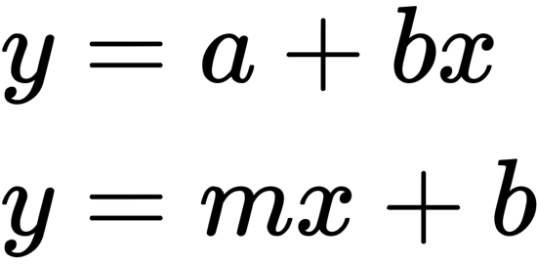
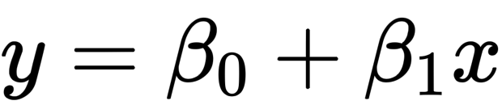
Simple Linear Regression
What is regression？
You may remember one of these:
In stats world, we change a different notation:
We call it ”linear” because the equation represents a straight line in a bi-dimensional plot

Slide 5
Simple Linear Regression
Variable‘s Roles
Dependent Variable
This is the variable whose values we want to explain or forecast
Its values depend on something else
We denote it as Y
Independent Variable
This is the variable that explains the other one.
Its values are independent.
We denote it as X.

Slide 6
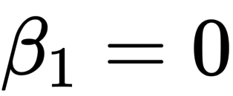
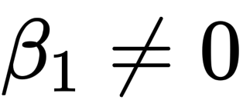
Simple Linear Regression
Model the linear relationship between a single quantitative X and a single quantitative Y
The Predicted/Mean value of y for a given x is the sum of the intercept plus the slope times the given x value
Hypothesis test:
H₀ ：
H_{A} :

Slide 7
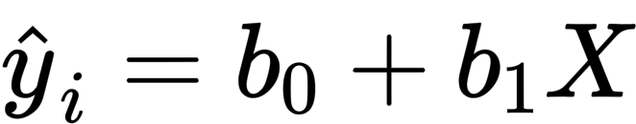
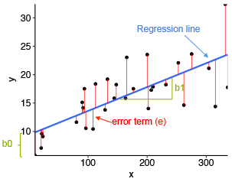
Simple Linear Regression
b₀ = estimate of intercept (mean value of y when x = 0)
b₁ = estimate of the slope (average change in y for every one unit increase in x)

Slide 8
Simple Linear Regression
Regression line is the ‘best’ line that minimizes the sum of squared errors
Error/residual represents what is NOT explained by the model

Slide 9
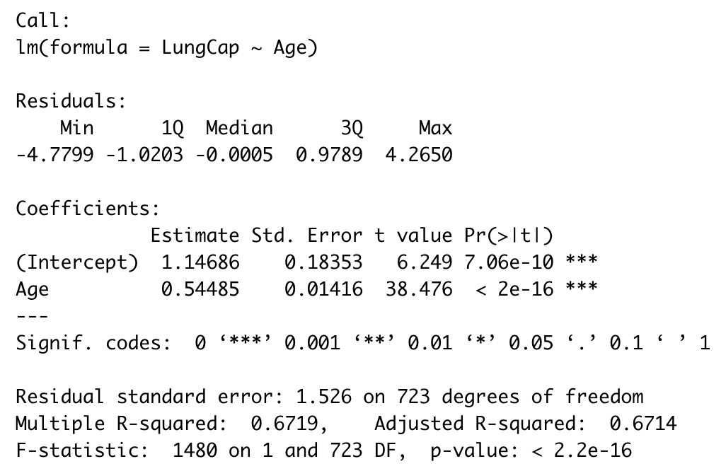
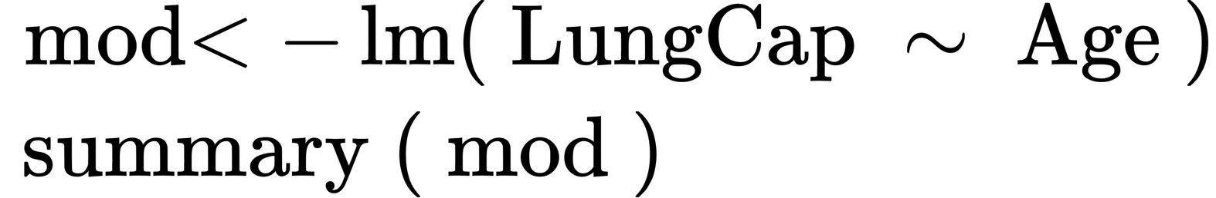
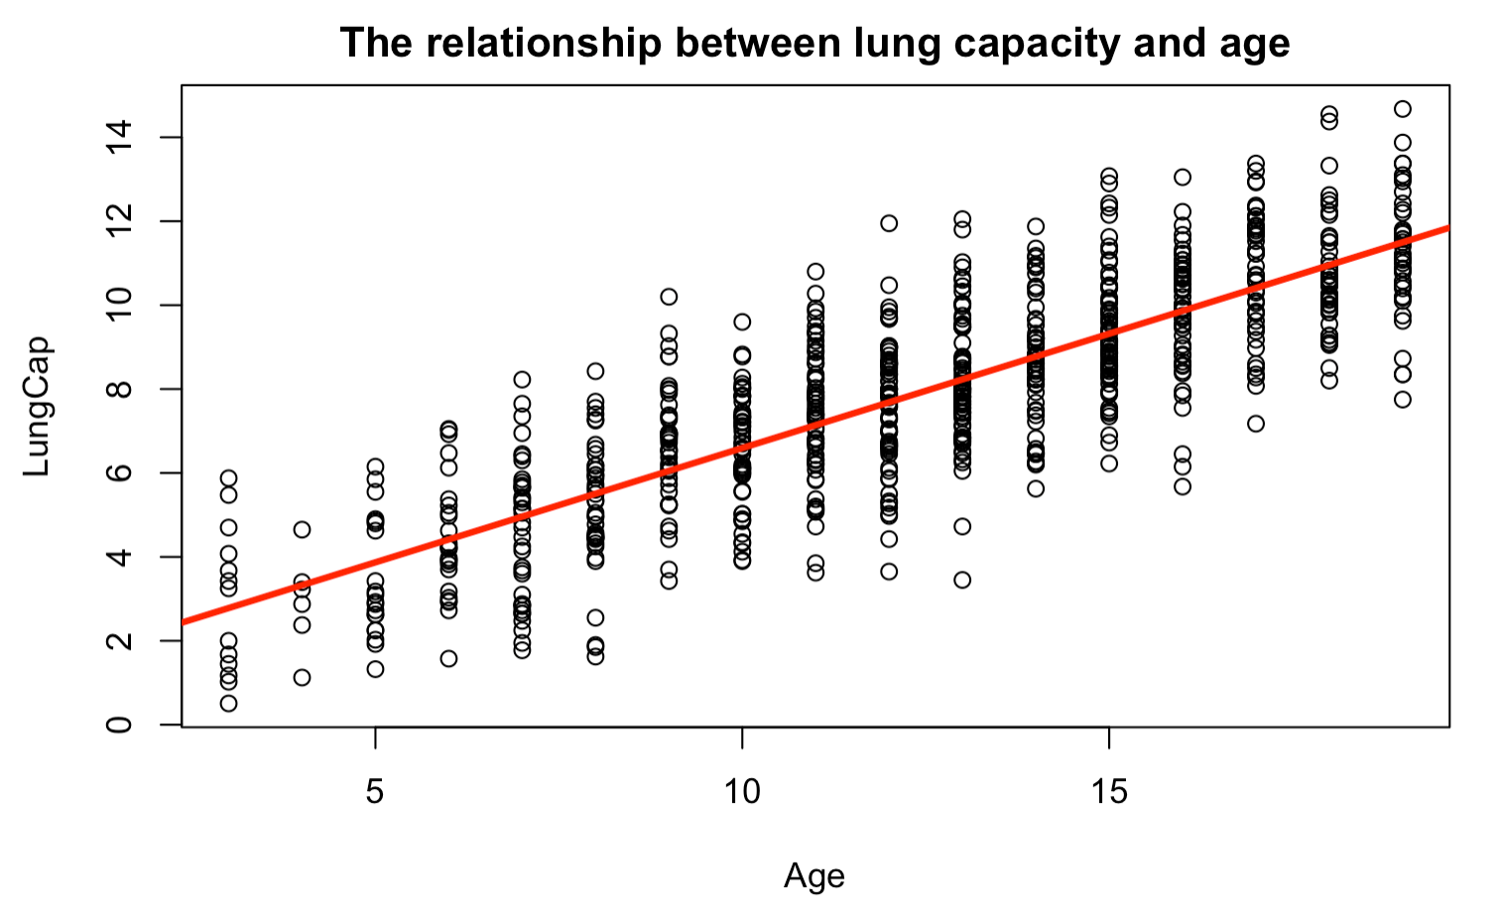
Simple Linear Regression
Interpret simple Linear regression output in R
y = 0.54485x + 1.14686

Slide 10
PART 02
Multiple Linear Regression

Slide 11
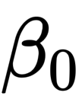
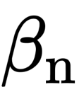
Multiple Linear Regression
: Mean value of y when every x = 0
: Mean change in y for a one-unit change in x, holding all
other x variable constant
Weekly Sales = 24520 + 3.5 × Advertising expenditure − 12.4 × Price + 0.1 × No. of mentions on Twitter in previous week + Noise

Slide 12
Multiple Linear Regression
X’s can be continuous or categorical
Continuous
Mean change in y for a one-unit change in x, holding all other x variable constant
Categorical
Mean difference in y between two groups of x, holding all other x variable constant

Slide 13
Continuous vs Categorical Variables
What professor attributes determine a professor salary :
A continuous dependent variable (y) : Salary
Continuous independent variables ( x’s ) : number of courses taught , number of publications
Categorical independent variables (x’s) : gender , university , rank , city etc.

Slide 14
The problem with Categorical Variables
The linear regression models assumes that the variables are numbers
What numbers should we give to the different categories?

Slide 15
Dummy Variables
They are binary variables, that takes values 0 or 1 – that represent if an observation belongs to a category of has an attribute.
They are also known as indicator variables, as they will generally have a value of 1 to indicate if an observation belongs to a category and a 0 to indicate if not.
We call them dummies since they are NOT real; we create them to represent something else.

Slide 16
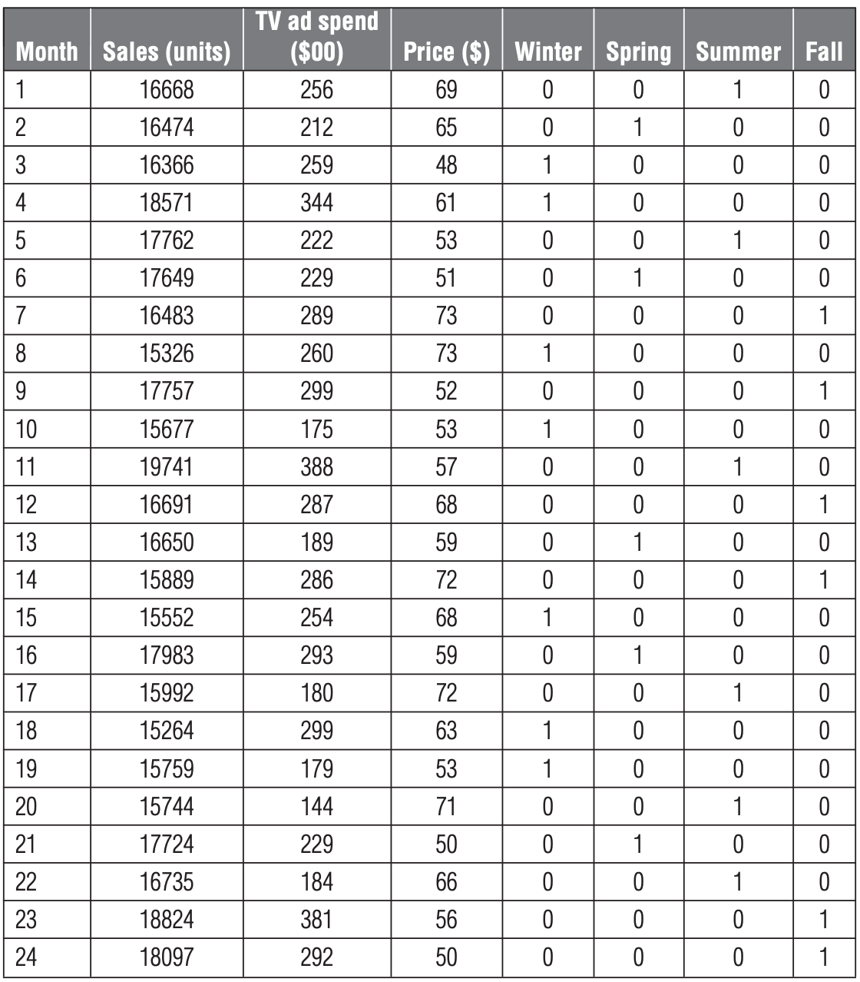
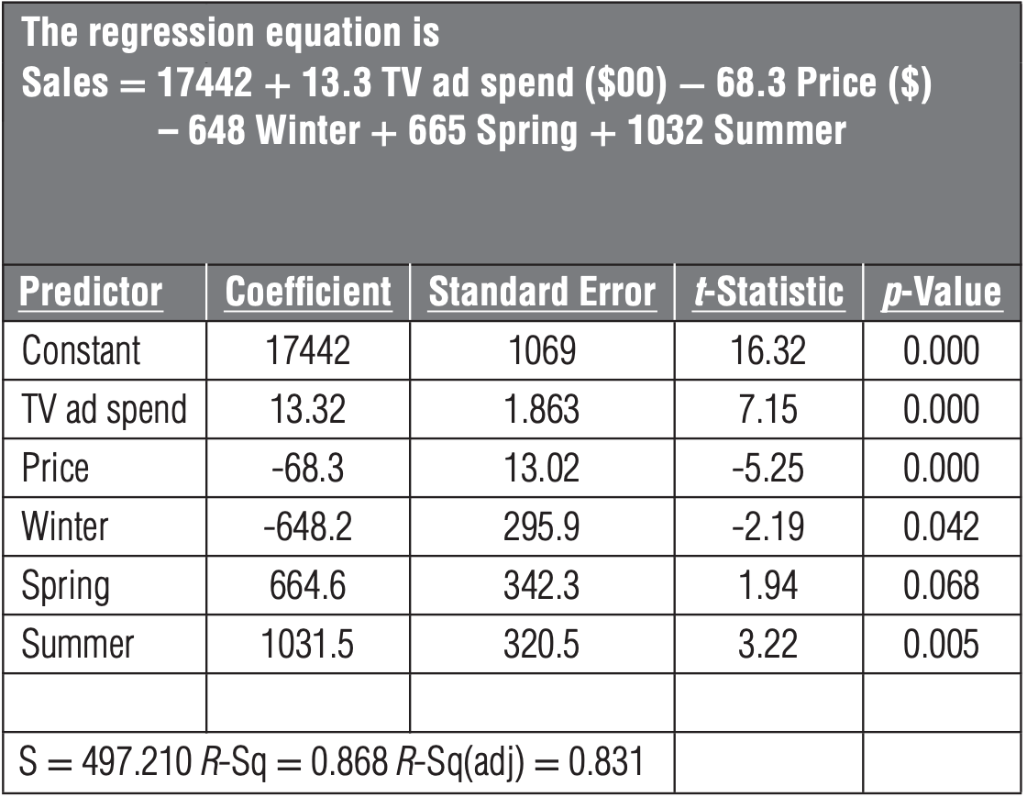
Dummy variables

Slide 17
Dummy variable
There are two categories : Smokers and non-smokers
We will create a dummy variable to indicate is an observation belongs to one of these:
Smokers = 1 if observation is a smoker
Non- smokers = 0 if observation is a non-smoker
We only need 1 variables to represent two categories !

Slide 18
Dummy variables
What if we have more than two categories?
A single dummy variable can only distinguish two
We use 3 dummies to represent 4 categories
Rules:
To represent K categories, we employ k -1 dummies

Slide 19
Multicollinearity
Occurs when 2 or more explanatory variables in a multiple linear regression model are highly correlated.
Accessing collinearity:
1. Correlations: Check the correlations between all pairs of x-variables
2. Variance Inflation Factors: Regression each x on the rest of other x’s

Slide 20
Multicollinearity
Multicollinearity can lead to three problems:
Large errors
Forecasting Reliability
Misleading P-values
It can lead to large errors in the estimates of coefficients of the prediction variables.
If you use the model for extrapolation, the forecast will not be reliable.
The p-values for the coefficients in the model can be misleading.

Slide 21
How to check the Multicollinearity?
Detection method 1 : Correlations
Check the correlations between all pairs of x-variables
Corr | X₁ | X₂ | X₃ | X₄
X₁ | 1
X₂ | 0.96 | 1
X₃ | 0.25 | 0.46 | 1
X₄ | -0.25 | -0.51 | 0.06 | 1
If correlation > 0.9 , this is a problem !

Slide 22
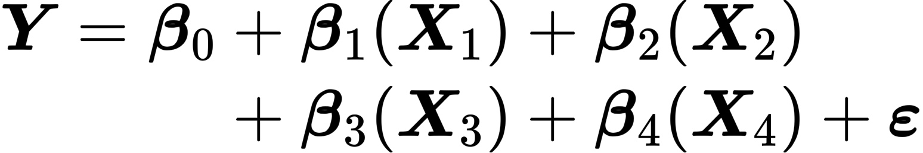
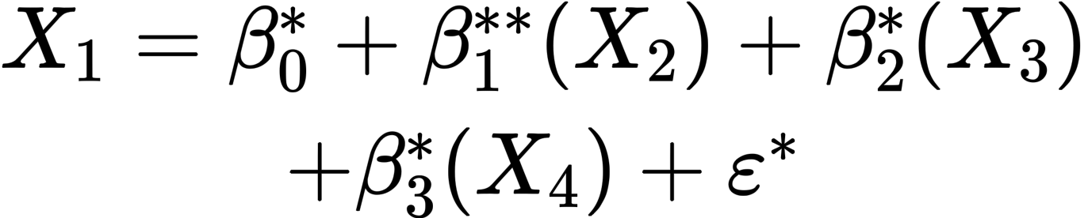
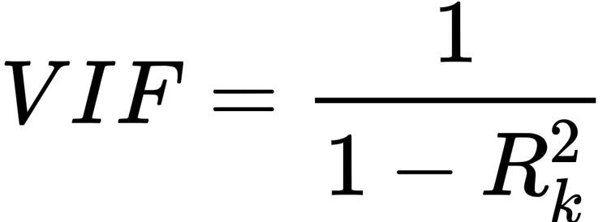
How to check the multicollinearity?
Detection method 2 : Variance Inflation Factors
A VIF, or variance inflation factor, reflects the imprecision in the estimate of a predictor variable that is caused by multicollinearity.
Find the VIF using the R-squared form each regression

Slide 23
How to check the multicollinearity?
Detection method 2 : Variance Inflation Factors
Find the VIF using the R-squared form each regression
Variables | VIF
X₁ | 3.5
X₂ | 0.4
X₃ | 6.2
X₄ | 10.6
if VIF > 10 , this is a problem !

Slide 24
Remedies
Option 1: Do nothing
If the model is used for prediction only
If correlated variables are not of particular interest to study question
If correlation is not extreme
Option 2: Remove one of the correlated variables
If variables are providing the same information
Note: be aware of omitted variable bias!
Option 3: Combine the correlated variables
Option 4: Ridge and Lasso regression

Slide 25
PART 03
Assumptions of Regression Analysis

Slide 26
Assumptions of SLM
Linearity
Independence
The association between the two variables is linear
L
I
Errors are independent
Normality
Equal variance
N
E
For each of X, the values of Y are normally distributed
(or errors are normal)
Error variance are constant

Slide 27
Checking Assumptions
Linearity
Normality
Diagnostic plot
(residual plot)
Q-Q plot
Equal variance
Independence
Knowledge of study design
Diagnostic plot
(residual plot)

Slide 28
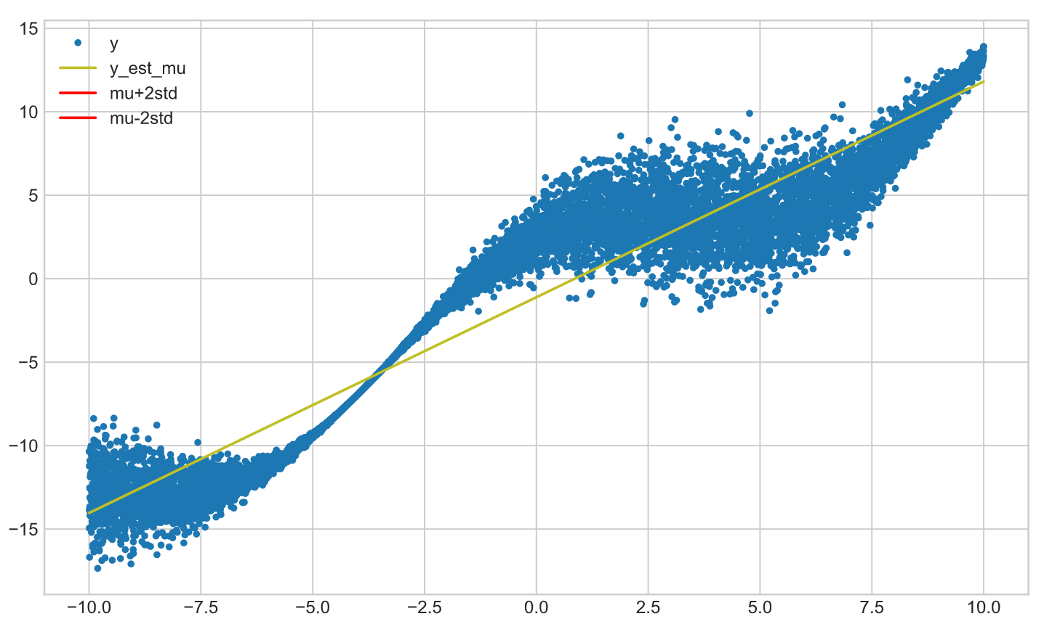
What can we do with non-linearity?

Slide 29
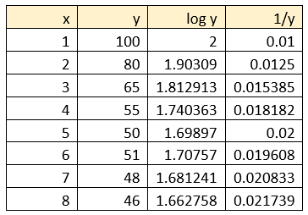
What can we do with non-linearity?
Transform ‘y’ variable
Pros:
Many different transformations available, which may lead to a linear relationship
It can address non-constant variance
Cons:
loose interpretability
Not able to address all non-linearities (only work for certain shapes)

Slide 30
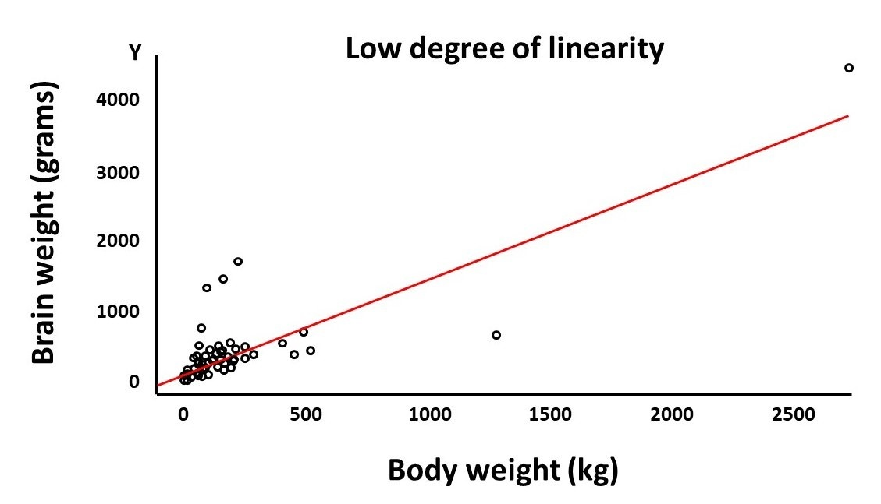
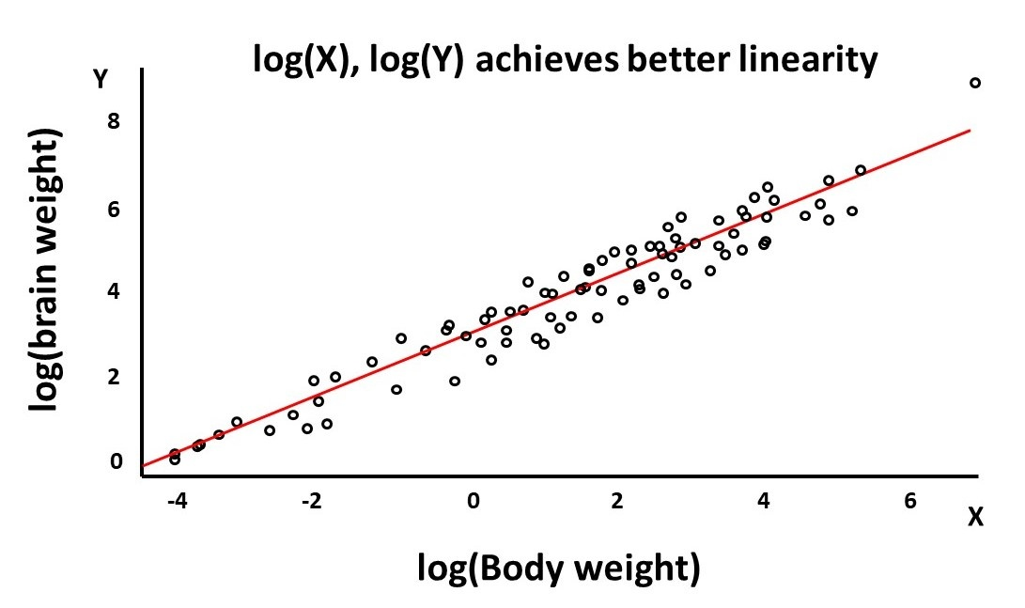
What can we do with non-linearity?
99 species that had a brain and body weight measurement

Slide 31
PART 04
Selecting The Best Models

Slide 32

R²
Proportion of the variation in the data that is explained by the model
Adjusted R² is “adjusted” for adding other variable in the model
The R² should NOT be used to compare the model fits!

Slide 33
How to select the best model?
Partial F-test
Partial F-test is used in model building and variable selection to help decide if a variable or term can be removed form a model without making the model significant worse
The larger model = Full model
The model with one or more variable removed = Reduced model
The partial F-test is used to compare the Nested model !

Slide 34
How to select the best model?
If we need to build a model to estimate the mean Lung Capacity using Age, Gender, Smoke, and Height.
Full model :
Reduced model :
The Reduced Model is Nested within the Full Model !

Slide 35
How to select the best model?
Does including Height in the model significantly decrease the error and significantly increase the predictive power of the model ?
Does the Height variable significantly improve the model ?
Hypothesis :
H₀ : Models do not significantly differ.
H_{A} : Full model is significantly better than the reduced model.
Simpler model is preferable !

Slide 36
How to select the best model?
To determine if the full model is significantly better, we will check if the sum of square error aka. The residual sum of square is significantly lower in the full model as compared to the reduced model.
Sum of square error :
It measures how close the model predicted y-value(the line) are to the observed y-value (the points).
In some sense, it can be thought as summarizing how well our model fits.

Slide 37
PART 05
Regression VS Univariate Methods

Slide 38
Regression VS Univariate Methods
Four Advantages:
More accurate
More credible
Regression models may be more accurate than univariate methods in some circumstances
Because regression provides explanations for its forecasts, these may be more credible to managers than “blind” extrapolation methods like exponential smoothing
More insightful
More period
Regression models can produce explanations for variations in sales, which can lead to more insightful forecasting.
Regression models can use information on the future values of predictor variables to forecast a long way ahead.

Slide 39
Regression VS Univariate Methods
Six Advantages:
Data has to be collected on the predictor variables. This may be costly and time consuming.
In many cases you need to forecast the future values of the predictor variables before you can forecast sales.
The regression models we have met are global models so they are not designed to adapt to change.
All the regression models assumed linear relationships between x and the y variables.
It is easier to automate the univariate methods
In some cases, the theoretical assumptions underlying regression analysis may be seriously violated.

Slide 40

All Models Are Wrong But Some Are useful !
---------by George Edward Pelham Box
(1919---2013)

Slide 41
Thanks!
ShiM9@cardiff.ac.uk
Shi Mingzhe
2020.10.13

